Slide 1

Department of Orthopaedic and Trauma Medicine Module: Traumatology Topic: Open Fractures Facilitator: Miss Regina Wambui

Slide 2
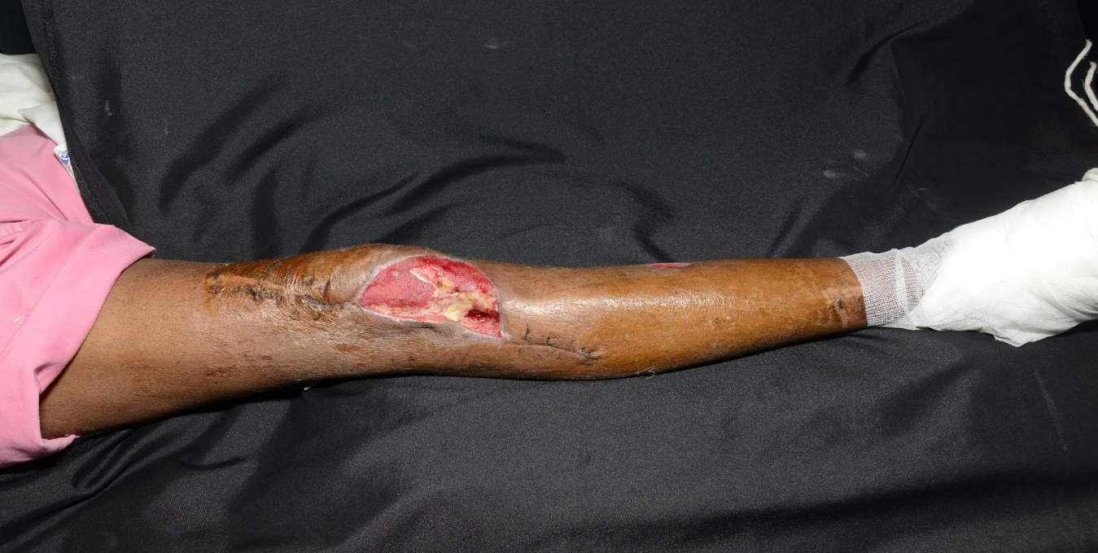
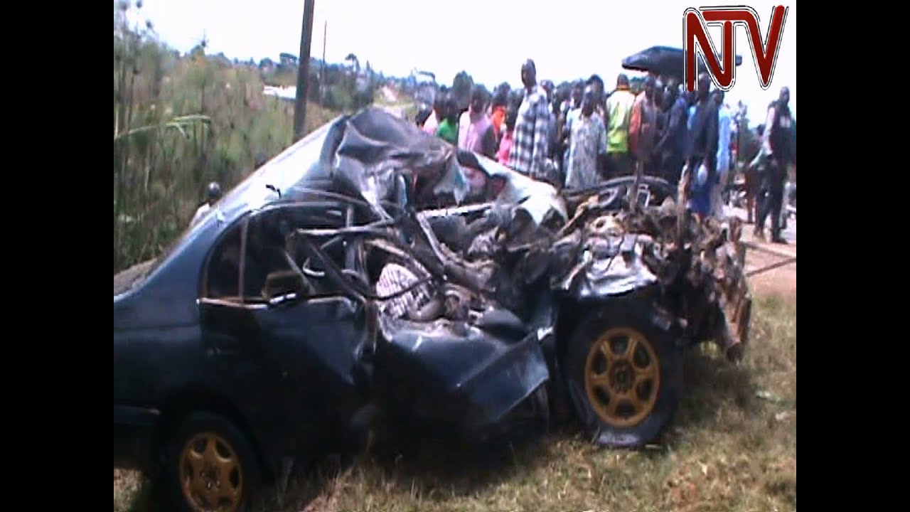
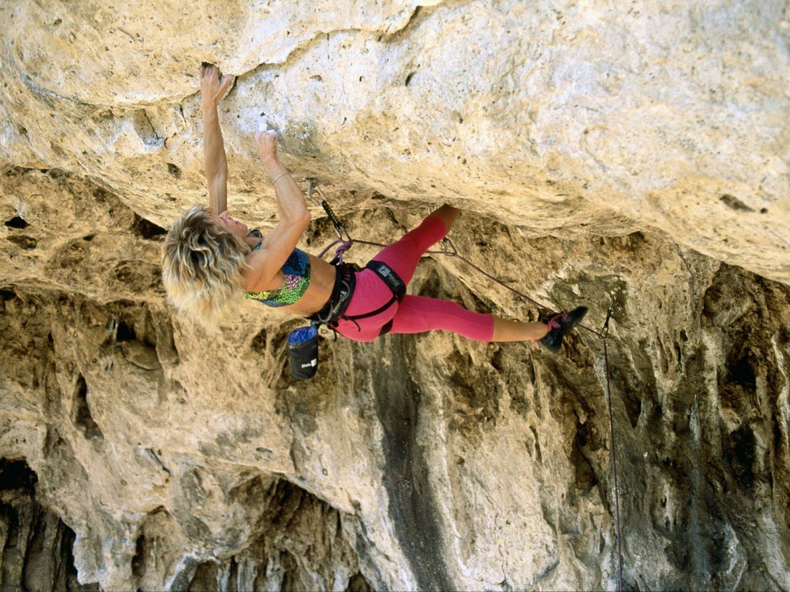
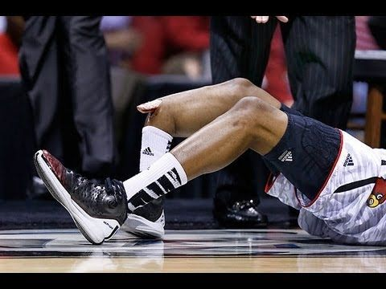

Slide 3
Learning Outcome
By the end of this lesson
you should be able to
Describe Open fractures

Slide 4
Learning Objectives
Define open fractures
Identify causes of open fractures
Classify open fractures

Slide 5
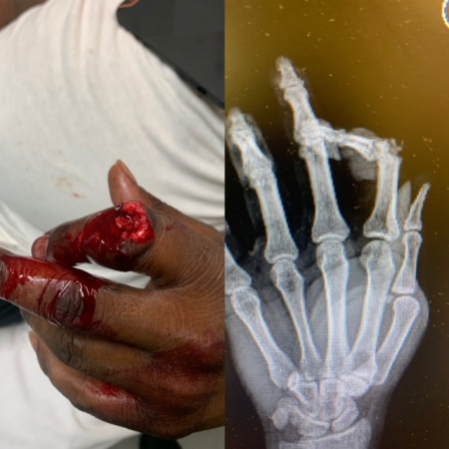
Introduction
It is a severe soft tissue injury
Broken bone that is in communication
through the skin with the environment
(Buteera and Byimana, 2009)

Slide 6
Introduction Cont
They are orthopaedic emergencies
Associated with high risk of infection
Have a high morbidity and mortality
compared to closed fractures
( Ibeanusi and Obalum, 2019)

Slide 7
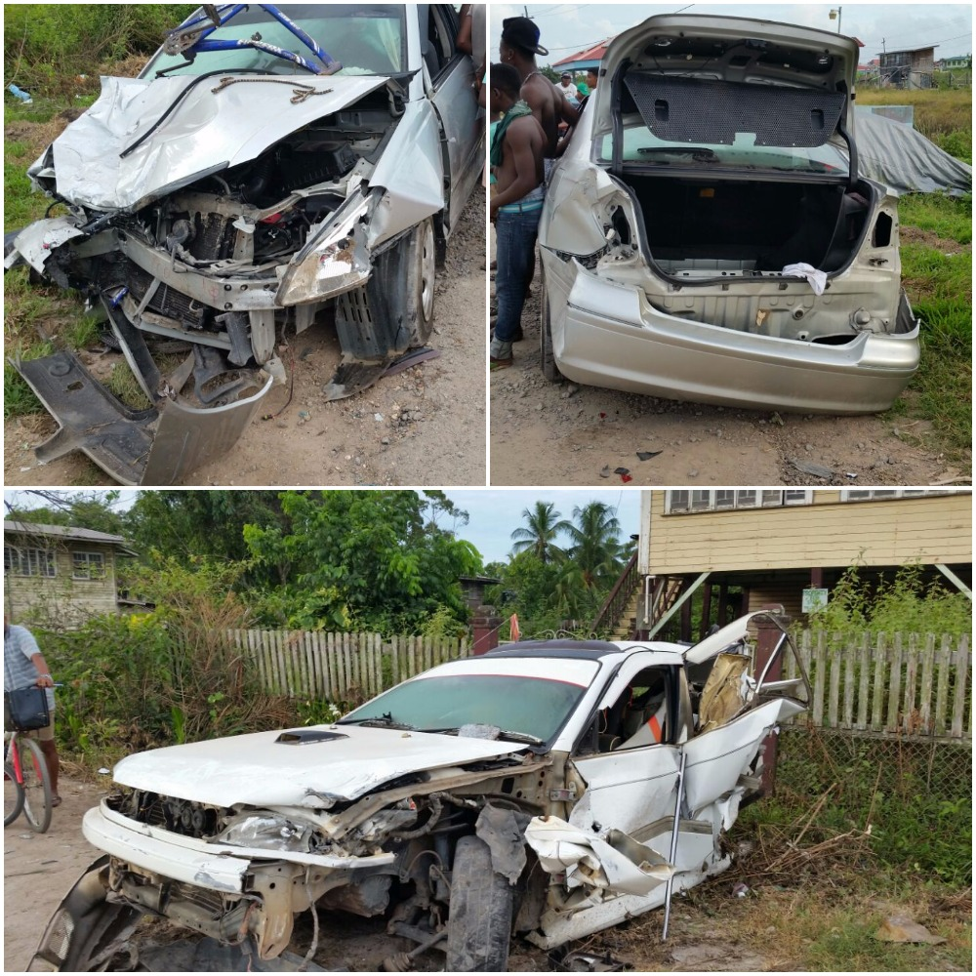
Causes of Open Fractures
Direct mechanisms
-Motor Vehicle Collisions(MVCs)
-Firearms
- Fall from a height
(Zalavras, 2017)

Slide 8
Causes cont
Indirect Mechanisms
-torsional injuries (sports)
- Fall from height
Extent of trauma directly related to
amount of energy

Slide 9
Classification (Aird, 2012)
Grading system focuses on severity of
limb injury only
The Gustillo-Anderson schema/ Tscherne and Gotzen
Provides a diagnostic framework that directs
treatment
Promotes communication between surgeons and clinicians

Slide 10
Gustillo-Anderson Classification
Classification based on:
Size of the wound
Level of contamination
Extent of soft tissue loss
Degree of fracture of comminution
( Elniel and Giannoudis, 2018)

Slide 11
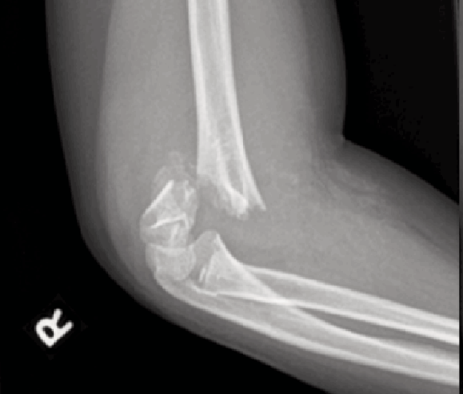
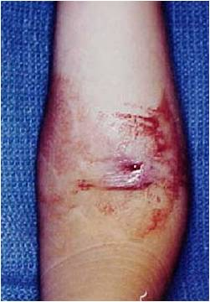
Classification cont
Type I (Gustillo 1)
Wound is <1cm in diameter
Simple # pattern with minimal comminution
Minimal soft tissue injury
Minimal contamination
Caused by low energy force

Slide 12
Cont
Type II (Gustillo II)
Wound is >1cm but <10cm
Minimal soft tissue loss
Moderate soft tissue damage
Moderate crushing or comminution of the fracture

Slide 13
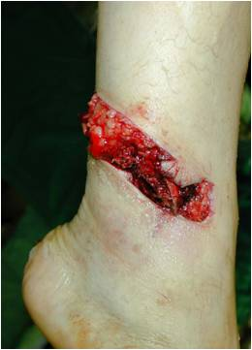
Gustillo II

Slide 14
Cont
Type III (Gustillo III)
Wound > 10cm
Extensive soft tissue loss
Highly contaminated
Moderate to severe crushing or comminution
Caused by high energy force
(Kumar and Namayan, 2014)

Slide 15
Cont
TYPE IIIA(Gustillo IIIA)
Extensive soft tissue loss
Severe contamination
Severe comminution of the fracture
Adequate soft tissue coverage using local
tissues
Caused by high energy force

Slide 16
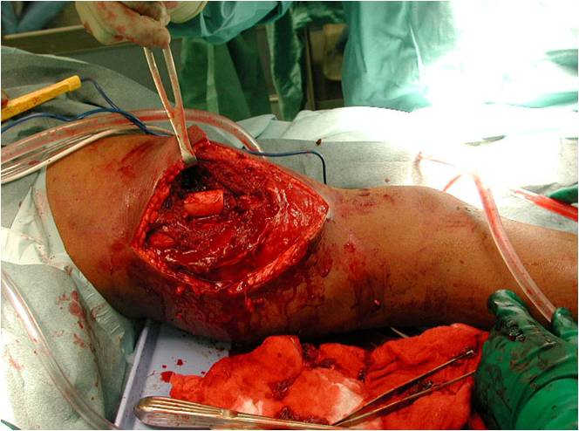
Gustillo IIIA

Slide 17
Cont
TYPE IIIB(Gustillo IIIB)
Extensive soft tissue loss with periosteal
stripping
Severe contamination
Fracture cover not possible with use of local
tissues.
Caused by high energy force

Slide 18
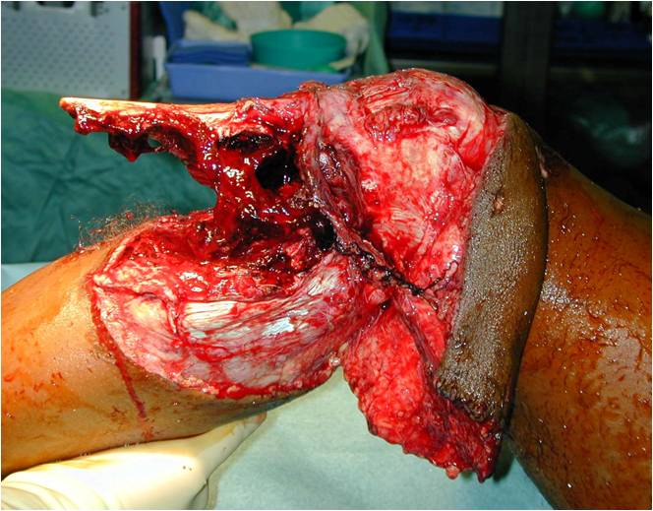
Gustillo IIIB

Slide 19
Cont
TYPE IIIC(Gustillo IIIC)
Any open fracture with vascular damage
Reconstructive surgery for skin coverage

Slide 20
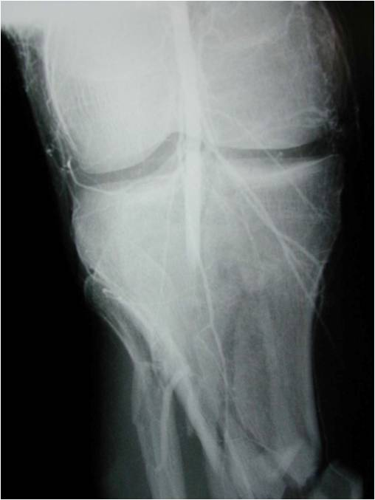
Gustillo IIIC

Slide 21


Slide 22
Summary: Open fractures
Evaluation of patient and injury
Soft tissue management
Fracture stabilization
Open fractures are difficult
High energy injuries

Slide 23
Summary ct…
Gustillo-Anderson classification is used for
prognostic framework
Grade I, II, III (A,B,C) dependent on wound size
amount of soft tissue injury
degree of contamination

Slide 24


Slide 25
Nadine, a 14 year old Was skiing, fell and broke her left leg. When she fell, her left leg was caught under the body of another skier who run into her. The x-ray showed that Nadine had an open, tibia-fibular fracture just below the knee. Giving details, describe the best management to Nadine’s Open fracture injury.

Slide 26
Halawi, M.J. and Morwood, M.P. (2015). Acute management of open fractures: an evidence-based review. Orthopedics, 38(11), pp.e1025-e1033.
https://www.ncbi.nlm.nih.gov/books/NBK448083
surgeryreference.aofoundation.org/orthopedic-trauma/adult-trauma/further-read…
www.bapras.org.uk/professionals/clinical-guidance/stand…

Slide 27
N/B
The assignment should be typed in
word not more than 300 words
Sent via email in pdf form
Font size of 12 headers at font size 16
Line spacing of 1.5
Work should be justified
Email: reginawambui261@gmail.com

Slide 28
References
Aird, J. (2012). Human Immunodeficiency Virus and open fractures. Is wound or fracture healing affected in surgically stabilised open fractures? A prospective study (Doctoral dissertation, UCL (University College London).
Buteera, A.M. and Byimana, J. (2009). Principles of management of open fractures. East and Central African Journal of Surgery, 14(2), pp.2-8.
Elniel, A.R. and Giannoudis, P.V. (2018). Open fractures of the lower extremity: current management and clinical outcomes. EFORT open reviews, 3(5), pp.316-325.
Kumar, G. and Narayan, B. (2014). Prevention of infection in the treatment of one thousand and twenty-five open fractures of long bones. Retrospective and prospective analyses. In Classic Papers in Orthopaedics (pp. 527-530). Springer, London.

Slide 29
References Ct…..
Ibeanusi, S.E.B. and Obalum, D.C. (2019). Open Fractures Treated in a Regional Trauma Centre in Nigeria: Presentation and Outcome-A Prospective Observational Study. Int Arch Orthop Surg, 2(007).
Zalavras, C.G. (2017). Prevention of infection in open fractures. Infectious Disease Clinics, 31(2), pp.339-352.

Slide 30


